Slide 1







Introduction to lucene
搜索&精准化 赵巍

Slide 2
Agenda
What is Apache Lucene ?
Focus of Apache Lucene
Lucene Architecture
Core Indexing Classes
Core Searching Classes
Demo
Questions & Answers
exercise

Slide 3
What is Apache Lucene?
Apache Lucene is a high-performance, full- featured text search engine library written entirely in Java.”
Also known as Information Retrieval Library.
Lucene is specifically an API, not an application.
Open Source

Slide 4
Focus
Indexing Documents
Searching Documents

Slide 5
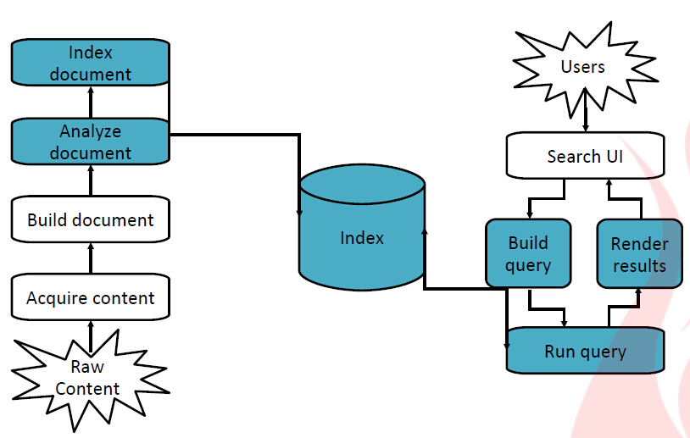
Lucene Architecture

Slide 6
Indexing Documents
IndexWriter writer = new IndexWriter(directory, analyzer, true);
Document doc = new Document();
doc.add(new Field(“content", “Hello World”,
Field.Store.YES, Field.Index.TOKENIZED));
doc.add(new Field(“name", “filename.txt",
Field.Store.YES, Field.Index.TOKENIZED));
doc.add(new Field(“path", “http://myfile/",
Field.Store.YES, Field.Index.TOKENIZED));
// [...]
writer.addDocument(doc);
writer.close();

Slide 7
Core indexing classes
IndexWriter
Directory
Analyzer
Document
Field

Slide 8
Directory
FSDirectory
RAMDirectory
DbDirectory
FileSwitchDirectory
JEDirectory

Slide 9
Analyzers
Tokenizes the input text
Common Analyzers
– WhitespaceAnalyzer
Splits tokens on whitespace
– SimpleAnalyzer
Splits tokens on non-letters, and then lowercases
– StopAnalyzer
Same as SimpleAnalyzer, but also removes stop words
– StandardAnalyzer
Most sophisticated analyzer that knows about certain
token types,lowercases, removes stop words, ...

Slide 10
Analysis examples
“The quick brown fox jumped over the lazy dog”
• WhitespaceAnalyzer
– [The] [quick] [brown] [fox] [jumped] [over] [the] [lazy] [dog]
• SimpleAnalyzer
– [the] [quick] [brown] [fox] [jumped] [over] [the] [lazy] [dog]
• StopAnalyzer
– [quick] [brown] [fox] [jumped] [over] [lazy] [dog]
• StandardAnalyzer
– [quick] [brown] [fox] [jumped] [over] [lazy] [dog]

Slide 11
More analysis examples
• “XY&Z Corporation – xyz@example.com”
• WhitespaceAnalyzer
– [XY&Z] [Corporation] [-] [xyz@example.com]
• SimpleAnalyzer
– [xy] [z] [corporation] [xyz] [example] [com]
• StopAnalyzer
– [xy] [z] [corporation] [xyz] [example] [com]
• StandardAnalyzer
– [xy&z] [corporation] [xyz@example.com]

Slide 12
Document & Fields
A Document is the atomic unit of indexing and
searching, It contains Fields
Fields have a name and a value
– You have to translate raw content into Fields
– Examples: Title, author, date, abstract, body, URL, keywords, ...
– Different documents can have different fields

Slide 13
Field options
Field.Store
– NO : Don’t store the field value in the index
– YES : Store the field value in the index
Field.Index
– ANALYZED : Tokenize with an Analyzer
– NOT_ANALYZED : Do not tokenize
– NO : Do not index this field

Slide 14
Searching an Index
IndexSearcher searcher = new IndexSearcher(directory);
QueryParser parser = new QueryParser(Version, field_name
,analyzer);
Query query = parser.parse(WORD_SEARCHED);
TopDocs hits = searcher.search(query, noOfHits);
ScoreDoc[] document = hits.scoreDocs;
Document doc = searcher.doc(0); // look at first match
System.out.println(“name=" + doc.get(“name"));
searcher.close();

Slide 15
Core searching classes
IndexSearcher
Query
QueryParser
TopDocs
ScoreDoc

Slide 16
IndexSearcher
Constructor:
– IndexSearcher(Directory d);
// Deprecated
– IndexSearcher(IndexReader r);
Construct an IndexReader with static method
IndexReader.open(dir)

Slide 17
Query
• TermQuery
– Constructed from a Term
• TermRangeQuery
• NumericRangeQuery
• PrefixQuery
• BooleanQuery
• PhraseQuery
• WildcardQuery
• FuzzyQuery
• MatchAllDocsQuery

Slide 18
QueryParser
• Constructor
– QueryParser(Version matchVersion,
String defaultField,
Analyzer analyzer);
• Parsing methods
– Query parse(String query) throws
ParseException;
– ... and many more

Slide 19
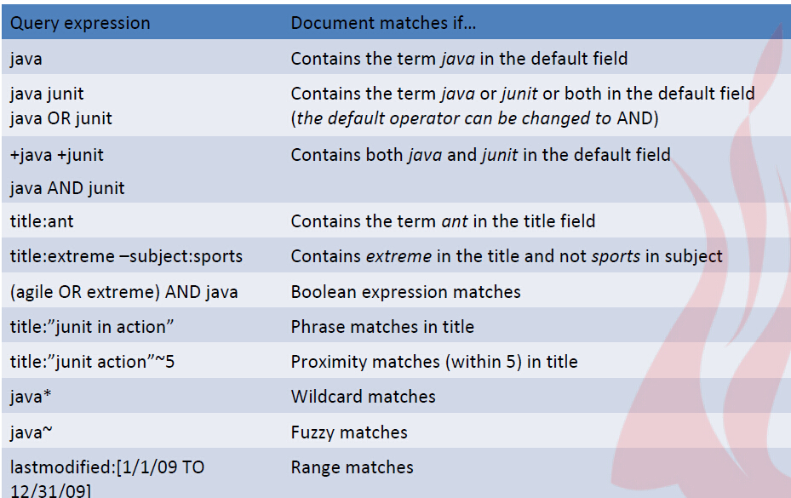
QueryParser syntax examples

Slide 20
TopDocs
Class containing top N ranked searched documents/results
that match a given query.
ScoreDoc
Array of ScoreDoc containing documents/results
that match a given query.

Slide 21
Questions & Answers

Slide 22
exercise
代码搜索应用
要求：
对一个（或多个）java project进行全文检索，在客户端（java或web）输入keyword，搜索出含有该keyword的java文件并打印。
可以多人合作完成。

